Slide 1
Sharkcycles - Team Proton Shark Park
Members: Vincent Bruno, Mason Glenn, Canaan Lockridge, Ramon Tillman

Slide 2
Contents
Phase I: Planning and Design
Phase II: Design Implementation
Project Requirements
Final System-Level Design
Initial Planning and Groundwork
Parts Acquisition
Concept Decisions
Phase II Work
Phase I Work
Conclusions / Improvements

Slide 3
Fall Semester
Phase I: Design and Planning

Slide 4
Project Requirements
Smart Parking Station
Self-sufficient
Easy to use
Low Profile

Slide 5
Initial Planning
Design a product that meets project requirements
Discuss different routes that we could take
Decide on a design and begin to flesh it out

Slide 6
Concept Decisions
Need to be orderly, self sufficient, and easy to use
Decided to take a physical station rather than a geofence
Expands on original team’s idea of RFID with solar power to keep it self sufficient

Slide 7
Work
Accomplished
Raspberry Pi and RFID communication.
Worked toward implementing modified Linka Lock
Began KiCad schematic of modified lock.

Slide 8
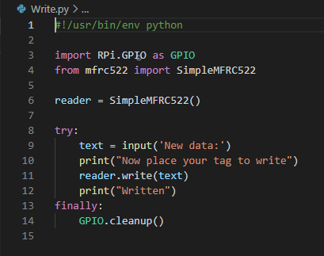
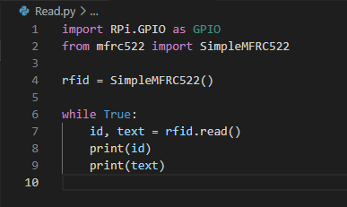
Raspberry Pi and RFID Communication
Connected Raspberry Pi to MFRC 522 RFID Reader
Wrote basic Python code to read/write to RFID tags
This would be our way of tracking state of the lock

Slide 9
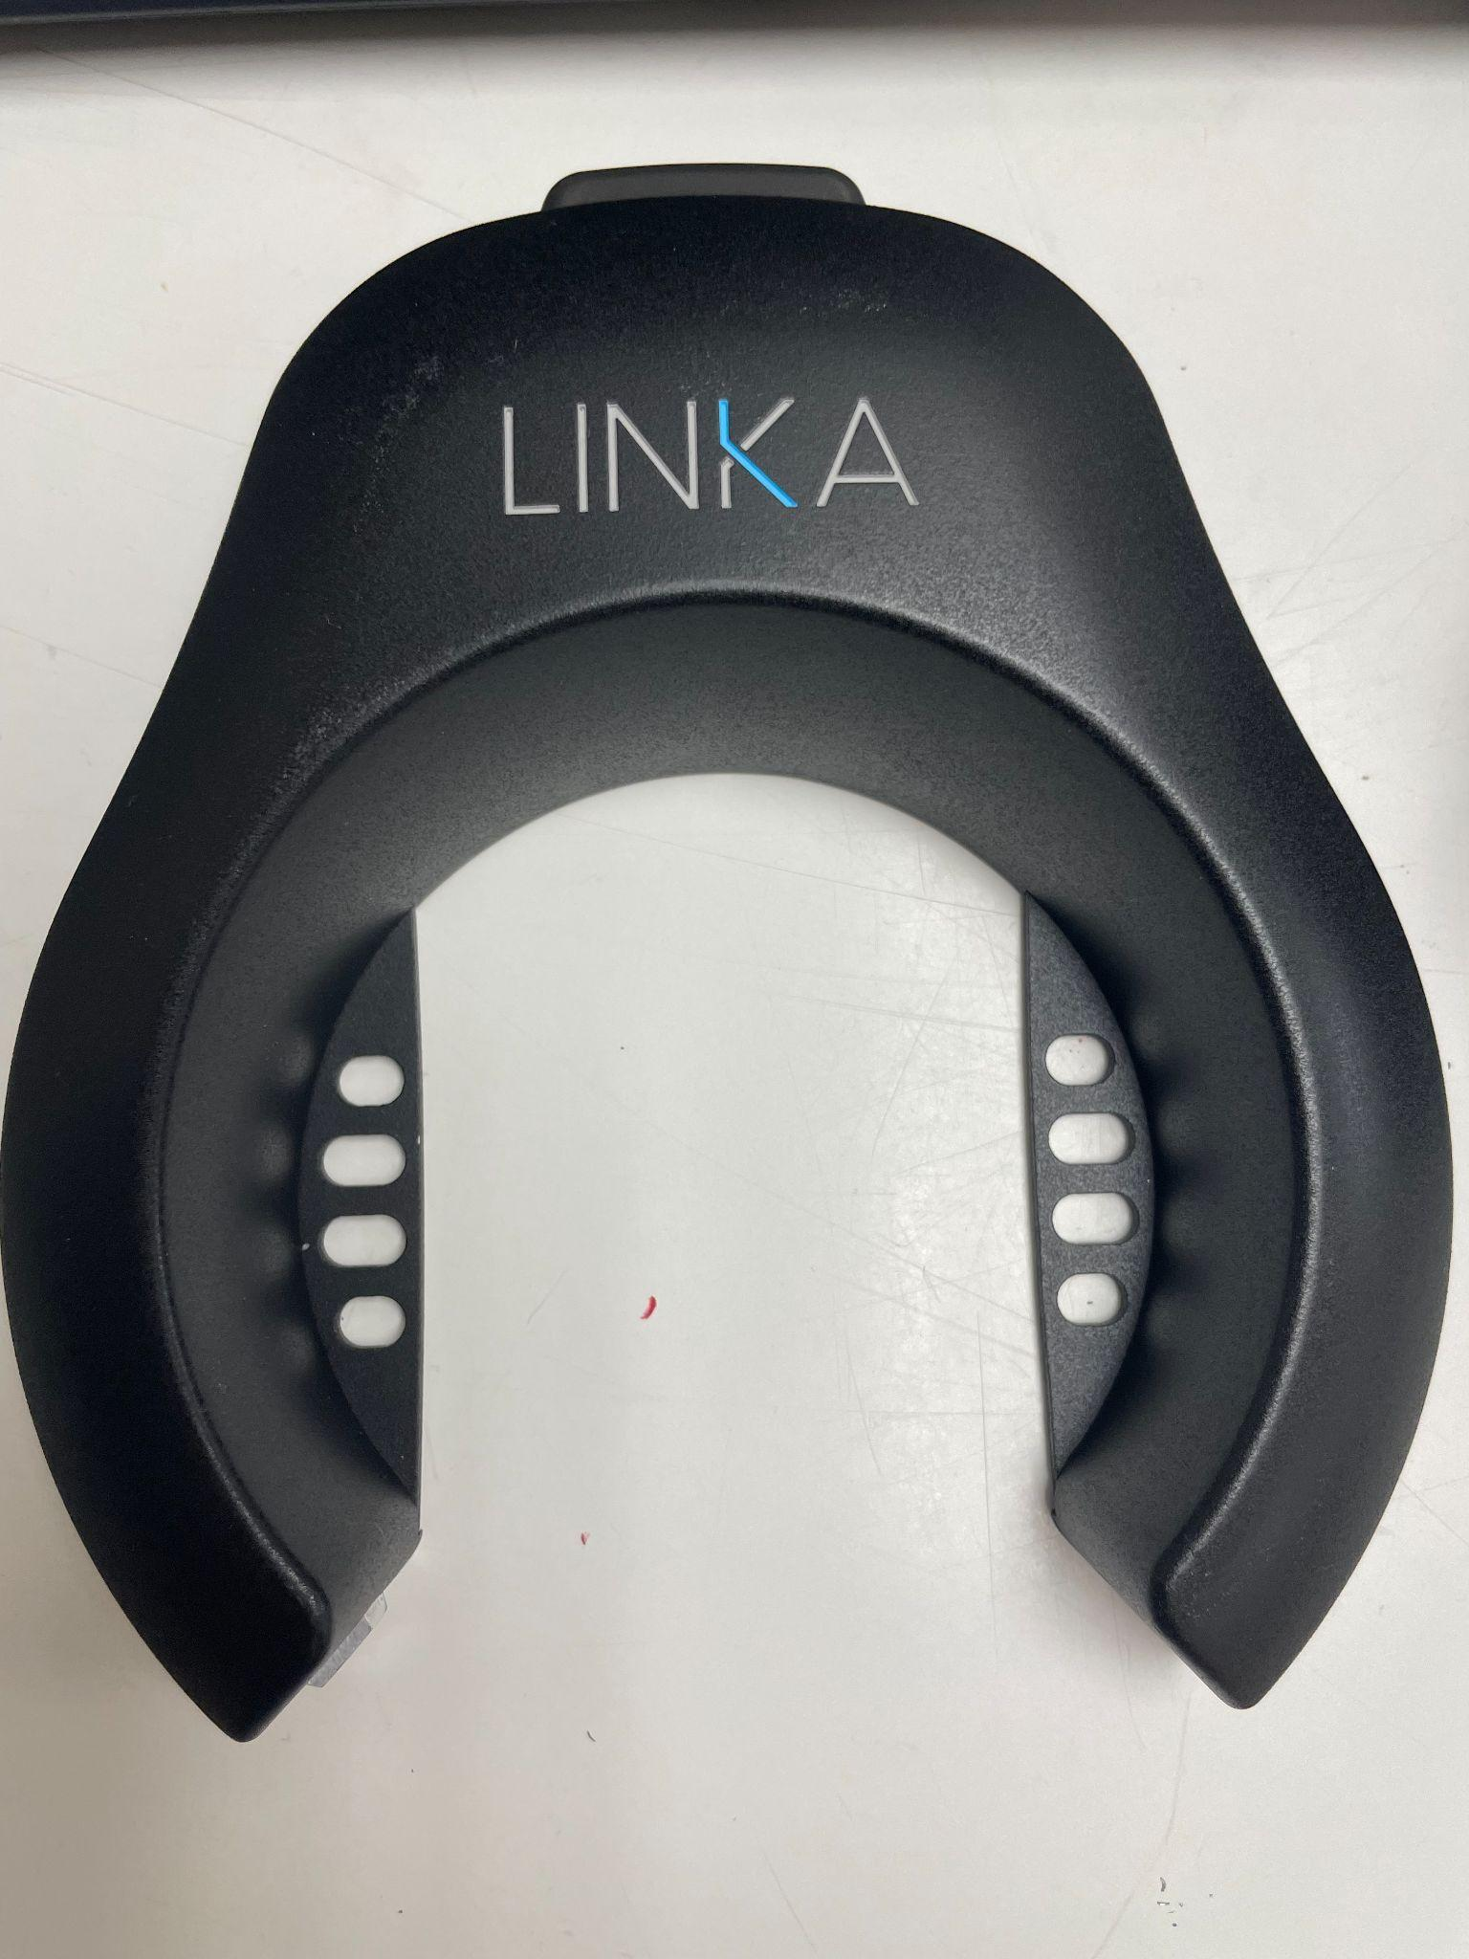
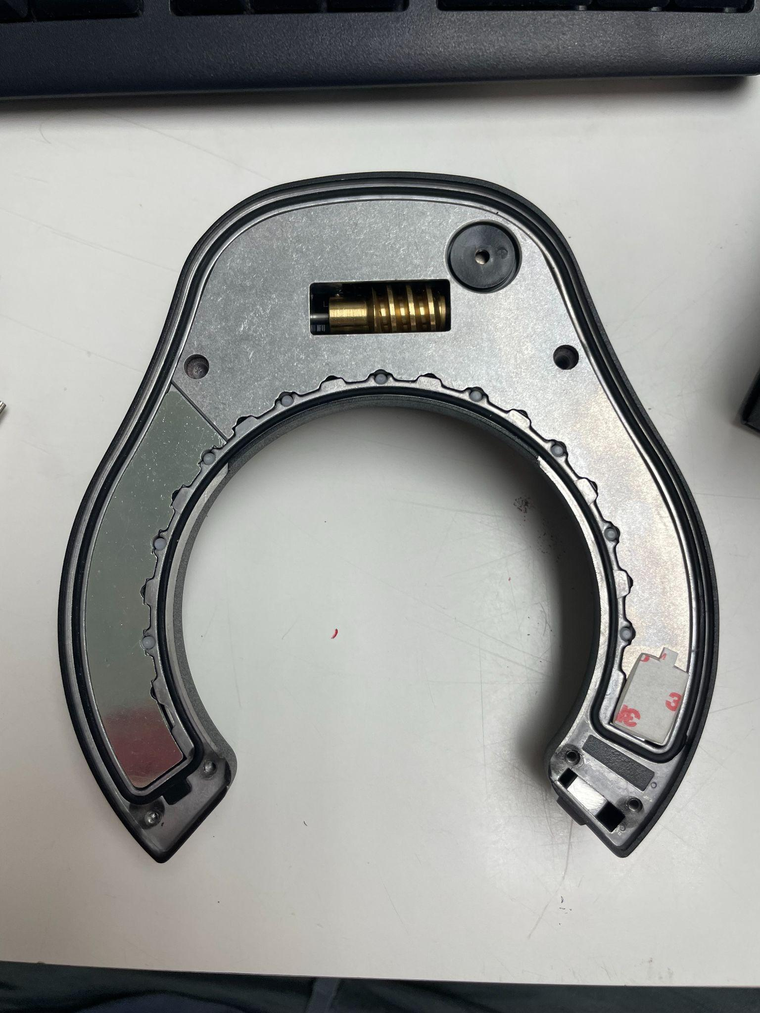
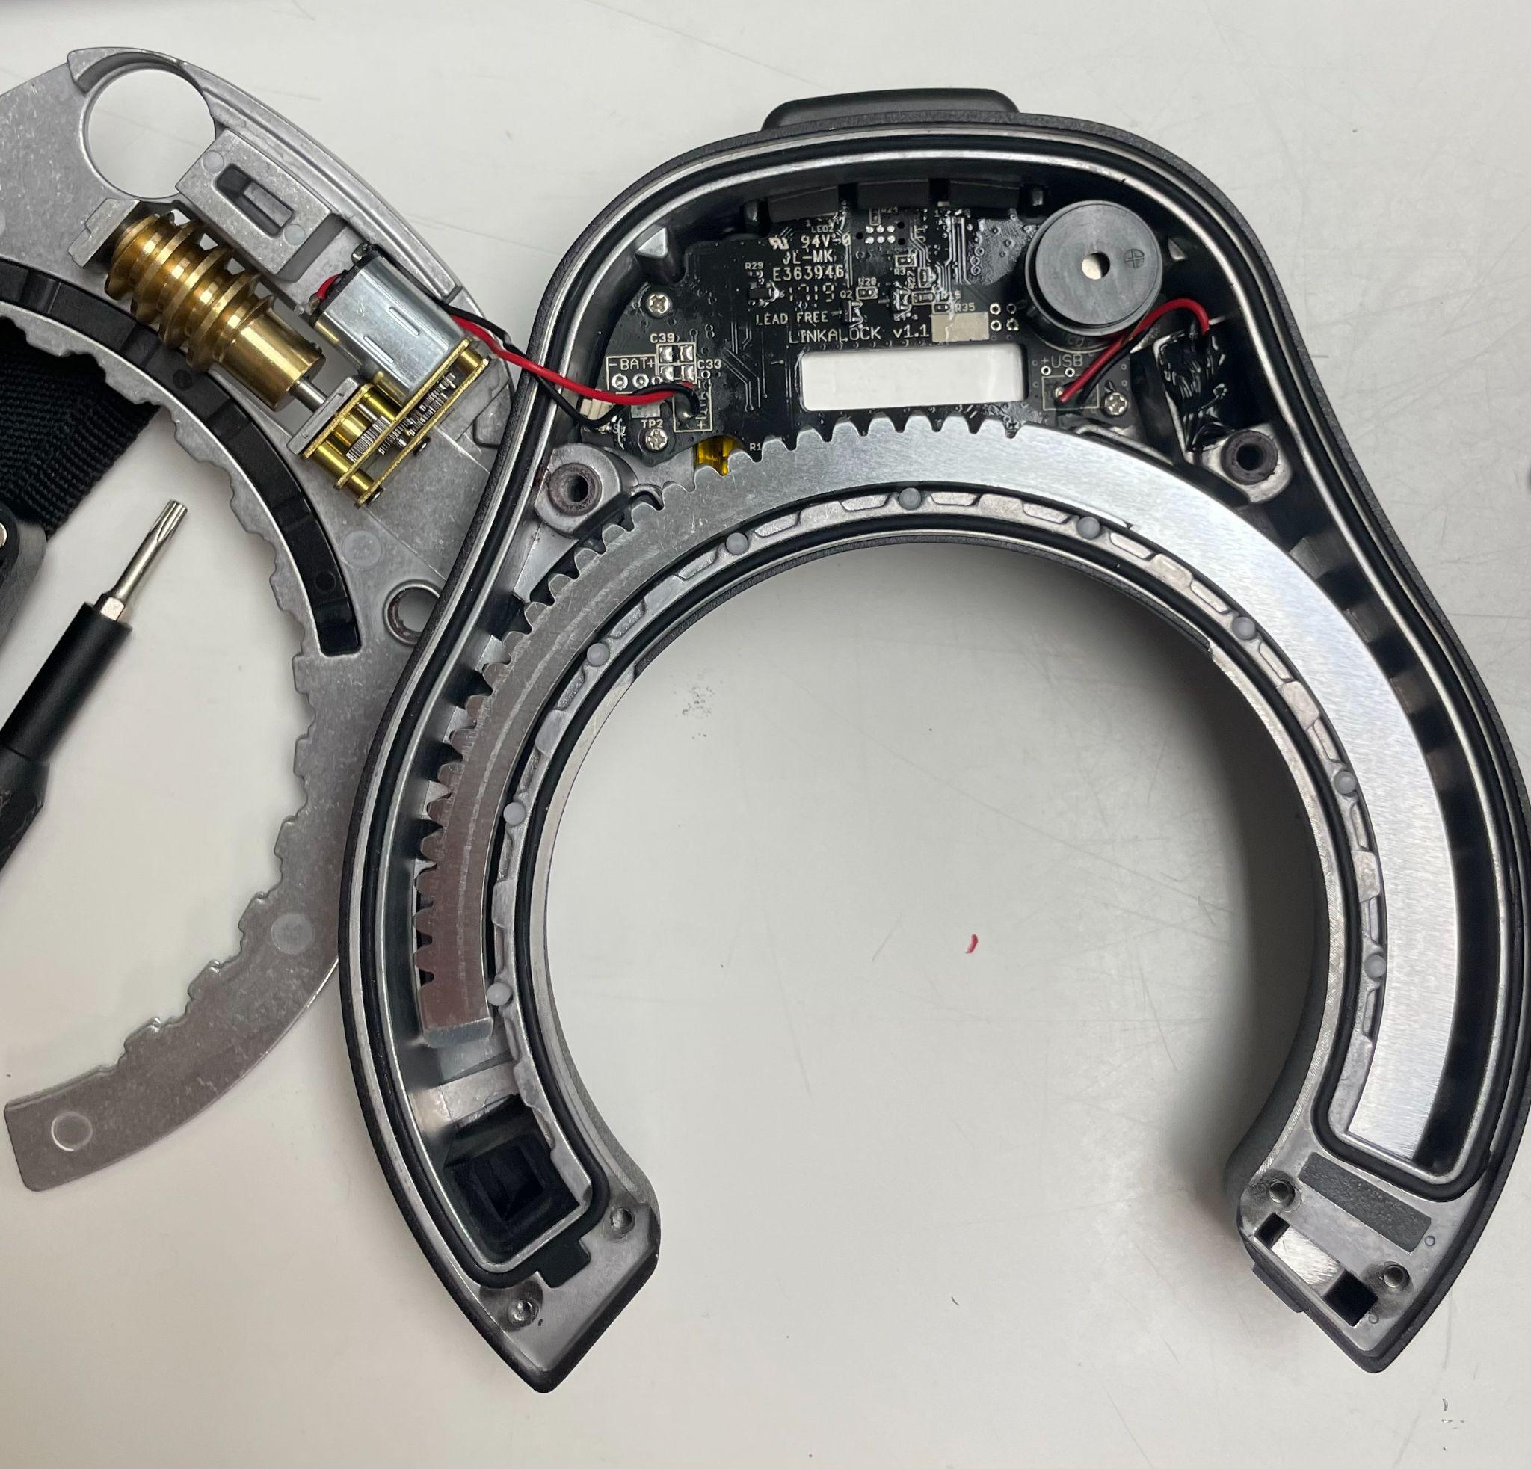
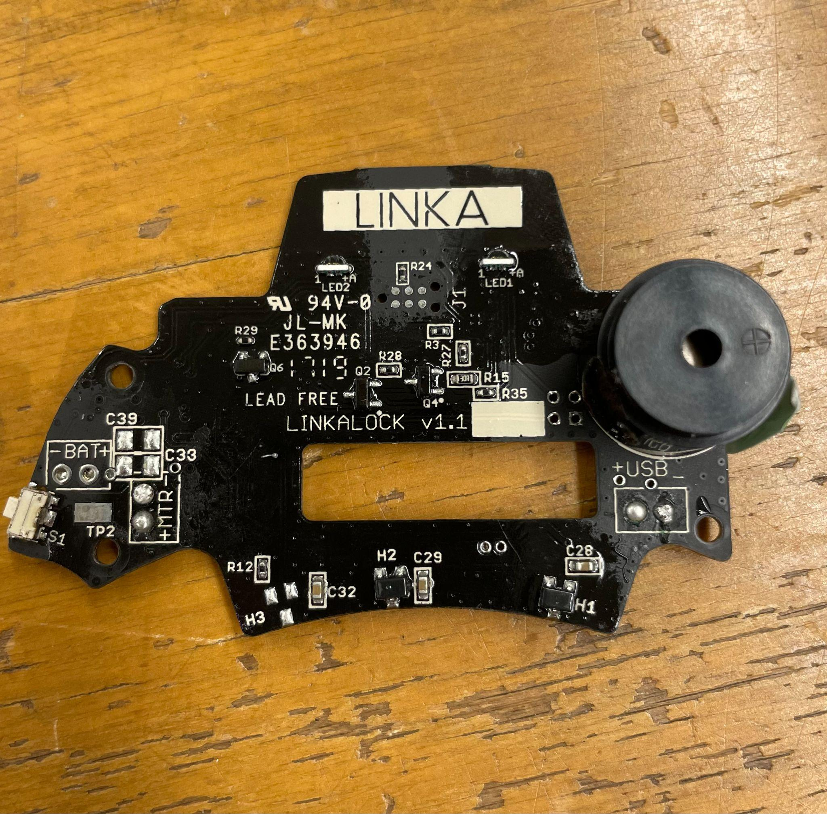
Linka Lock
Deconstructed and modified the linka lock
This deconstruction allowed for further examination. We found out that the motor draws ~80 mA of current at 3V, but it begins operating at around 1V.

Slide 10
Beginning Kicad
Initially wanted to replicate the Linka Lock’s functionality on our own kicad designed pcb
However due to the difficulty of obtaining the proprietary parts needed we were unable to do so

Slide 11
Confounding Factors
Conflicting Approaches in the beginning
Issues with Linka PCB components
Time management issues in the beginning

Slide 12
Spring Semester
Phase II: Design Implementation

Slide 13
Final Design
Use Raspberry Pi to be the brain and use RFID to open and close the lock
Use a solar charge controller to regulate power between battery solar panel and Raspberry Pi
Began trying to use an Arduino to send signals via serial to activate lock

Slide 14
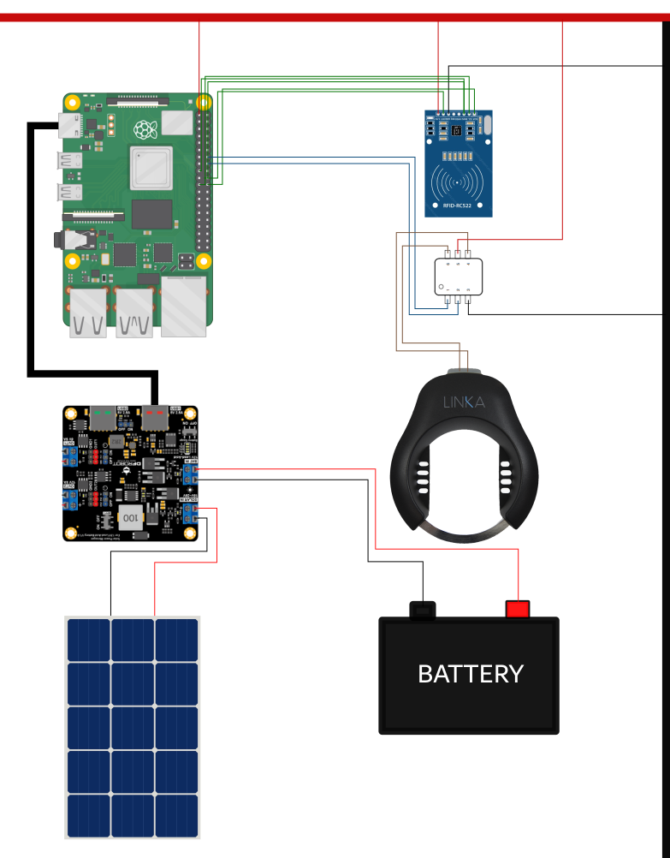
Final Design
Cont.

Slide 15
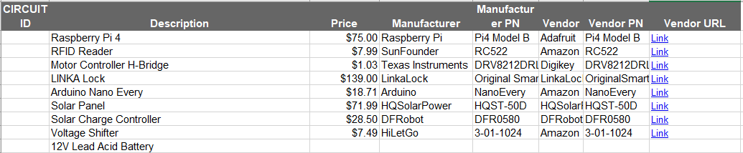
Part Acquisition

Slide 16
Work Accomplished
H-bridge to control current flow to the motor of the lock.
Implemented solar panel with solar charge controller
Got necessary adaptors to integrate everything together

Slide 17
Work Accomplished
Got everything pieced together
Finalized the controlling software
Attempted to interface with arduino from RPi with serial communication

Slide 18
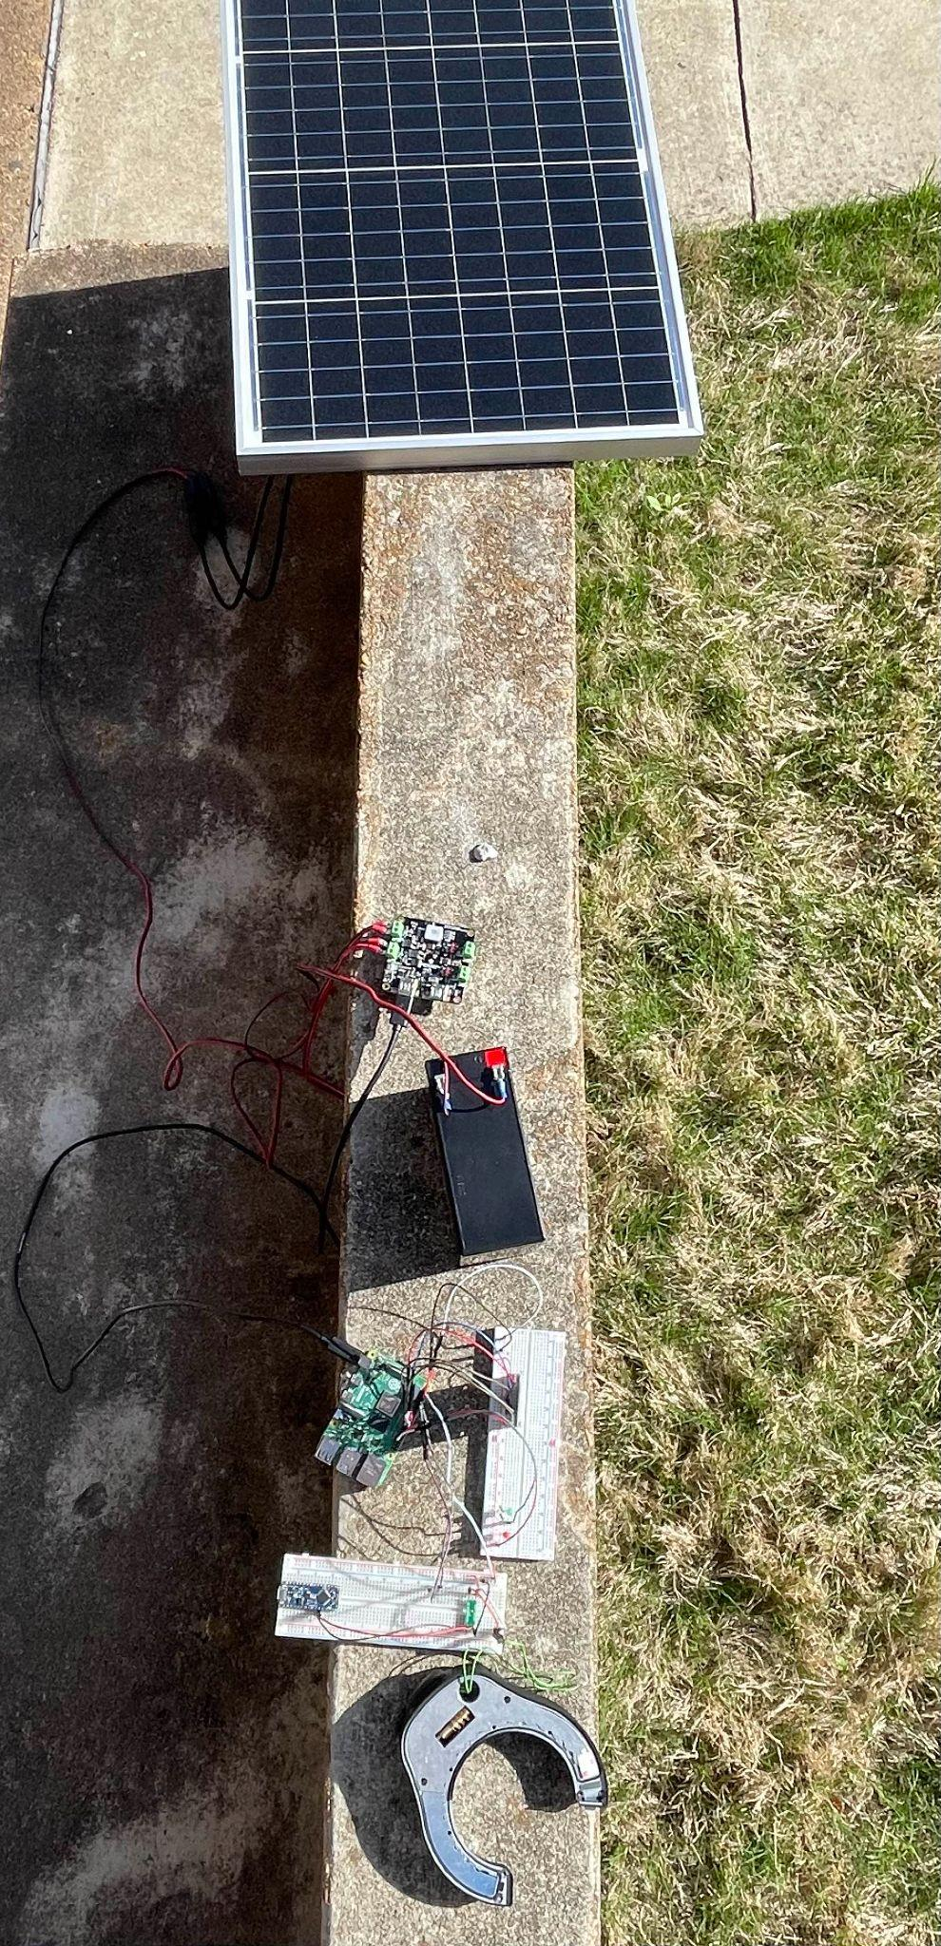
Piecing It together
Verified that solar panel charged battery
Were able to power RPi and peripherals from battery
Confirmed RFID signals sent to Raspberry Pi
Sent digital high values to open and close pins on H-bridge

Slide 19
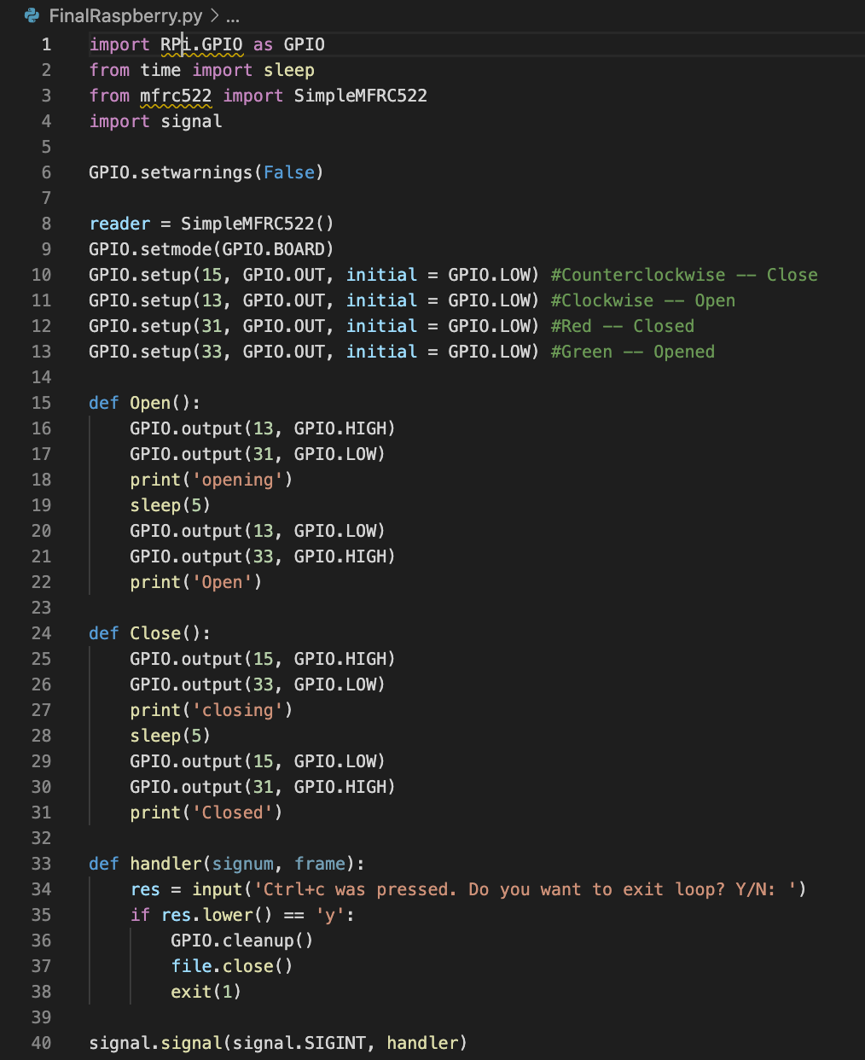
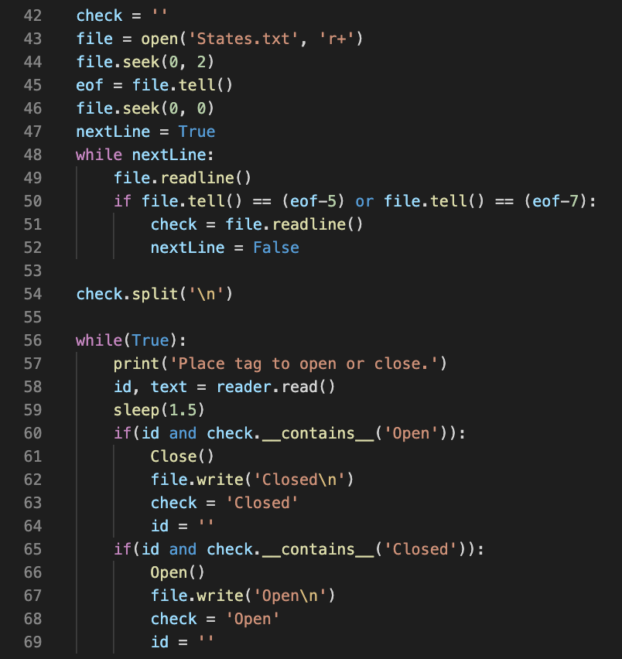
Control Software

Slide 20
Arduino Nano Work
Attempted to communicate between RPi and Arduino via Serial
Initially communicated over USB Serial
Switched to Arduino and RPi TX/RX GPIO pins
Due to time constraints, Arduino connection did not come to be

Slide 21
Confounding Factors
Ran into interfacing problems between the Rpi and RFID
Serial communication between RPi and Arduino Nano
Wiring everything together

Slide 22
Conclusions
We were able to develop a single RFID - Lock interface
A unified vision was helpful in development
Always double-check tolerance values

Slide 23
Improvements
Implement a queue system to handle multiple requests
Successfully implement serial communication to allow for more locks
Design a PCB that implements all functionality
Eventually send data to Sharkcycles server

Slide 24
Demo

Slide 25
Questions?

